Slide 1
School project
ZŠ Na Lukách

Slide 2
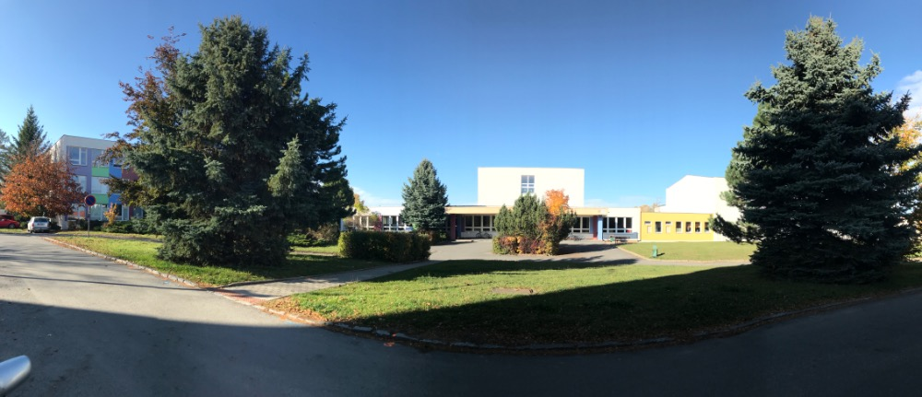
Our school

Slide 3
Coming to school

Slide 4
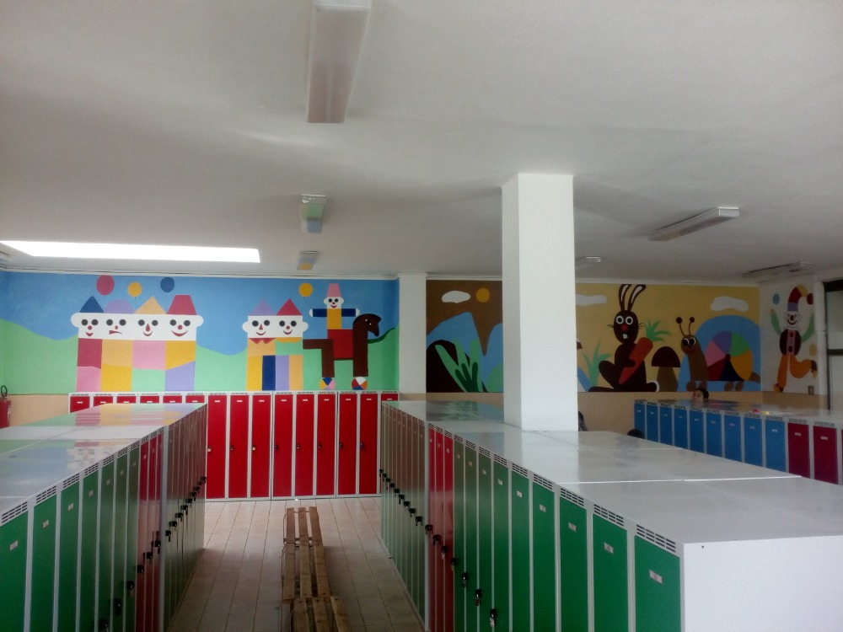
Changing rooms

Slide 5
School playground

Slide 6
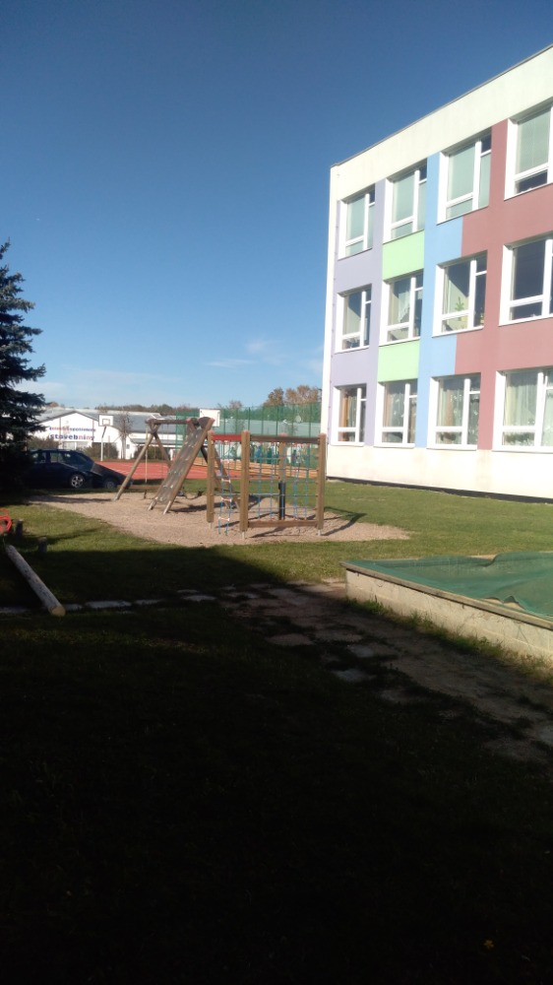
Playground

Slide 7
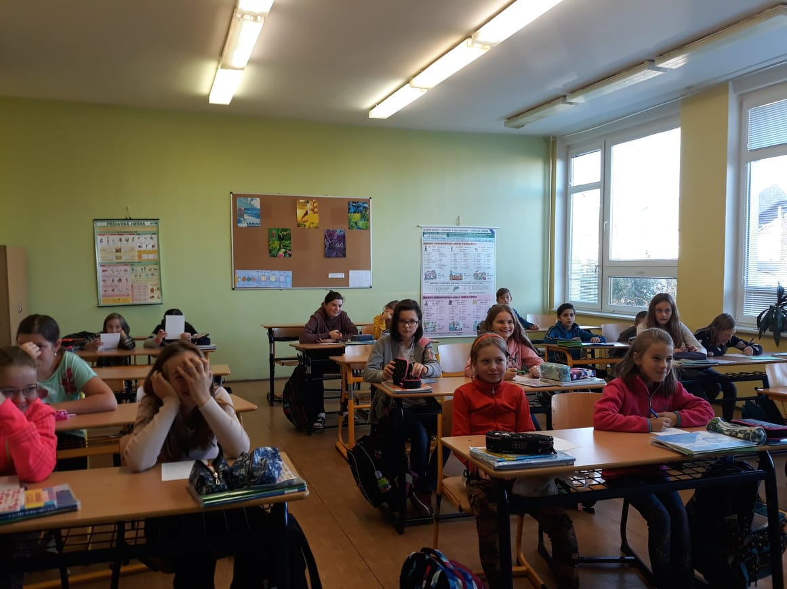
Class

Slide 8
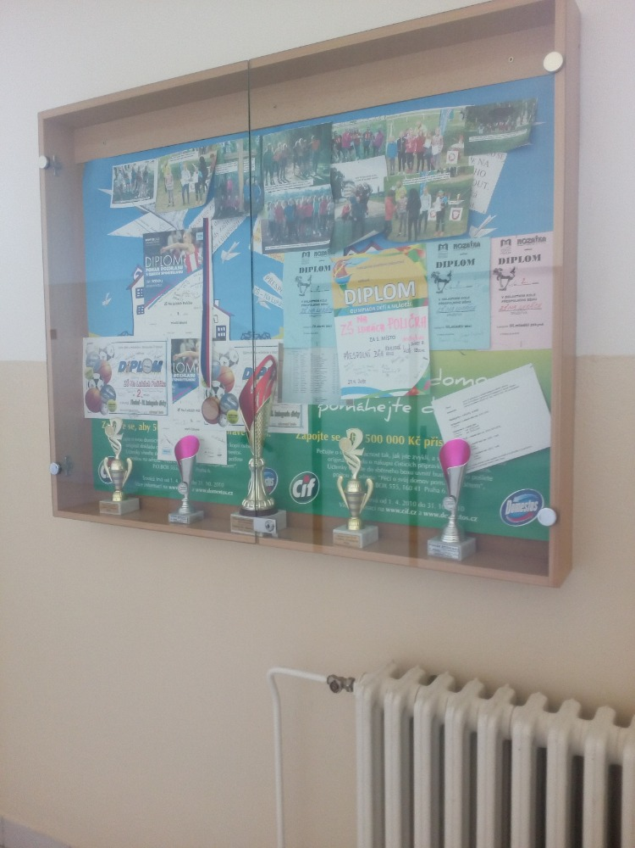
Gym

Slide 9
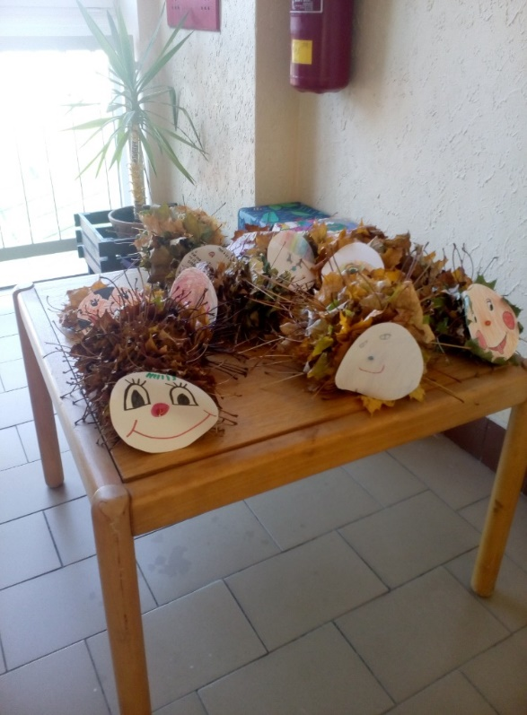
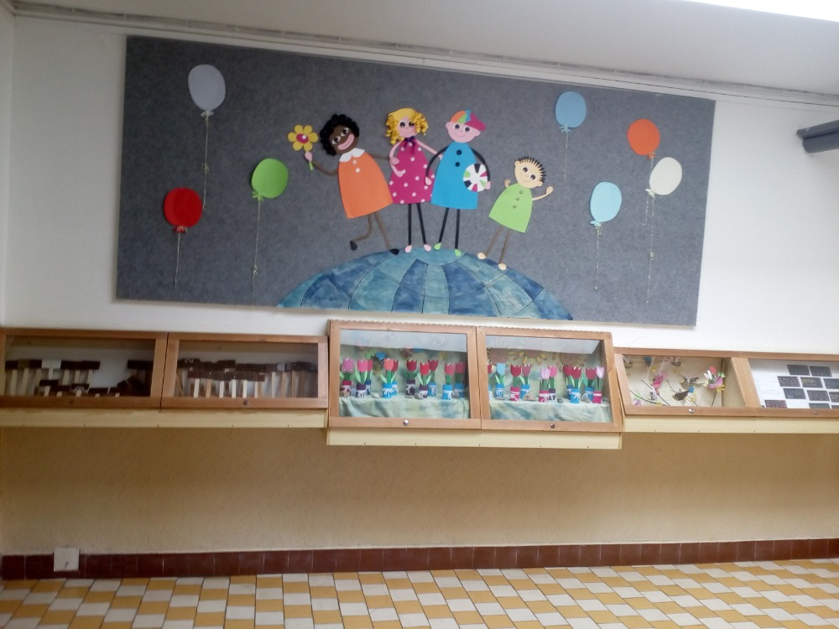
Art

Slide 10
Corridor

Slide 11
THE END=)
Bye, we look forward to seeing you when you go to our school!

